Slide 1
ASME
Model-Based Enterprise Standards to Support the Digital Twin
November 12, 2020
Jennifer Herron, MBE Vice-Chair
Notes:
Hello everyone. My name is Jennifer Herron.

Slide 2



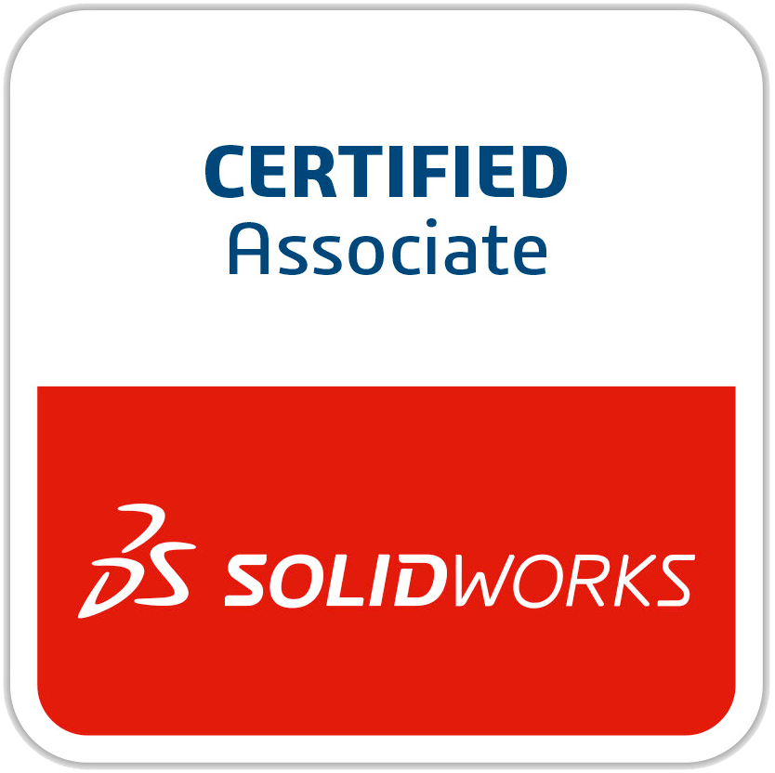









Jennifer Herron
Expertise | MBD and MBE Solution Architecture MBD Pilot Planning MBD Modeling Standards and Best Practices Multi-CAD MBD Authoring and Publishing Multi-CAD MBD and GD&T Coaching Strategic MBD and MBE Implementation Coaching MBD Supply Chain Readiness Coaching
CREDENTIALS | Board Member, Digital Metrology Standards Consortium (DMSC) Vice-Chair, MBE ASME Committee Member, ASME IAB Member AIAG TDP Working Group Certified Scrum Product Owner® Engineer in Training (EIT), Missouri Certified SolidWorks Associate Patent for Toroidal Propulsion and Steering System (Snake)
PUBLICATIONS | Re-Use Your CAD: The Model-Based CAD Handbook – Edition 1 and Edition 2 Industry Blogs
Quote | If you are going to CHANGE the results of your business, you have to change the WAY you do business.
ASME MBE STANDARDS Committee VICE-Chair
Jennifer Herron
Notes:
I am the vice-chair and Communications Director of the ASME Model-Based Enterprise Standards Committee.
Standards aren’t always fun or nearly as exciting as new digital twin technologies. However, they are crucial to the sustainable success of digital twin methodologies at scale.

Slide 3

Any information presented is governed by a rigorous ANSI process.
All standards content in this presentation is DRAFT-ONLY.
Notes:
Any information presented is governed by a rigorous ANSI process, but we do like to keep you informed about our work. Please know that what we show you today is in draft format.

Slide 4
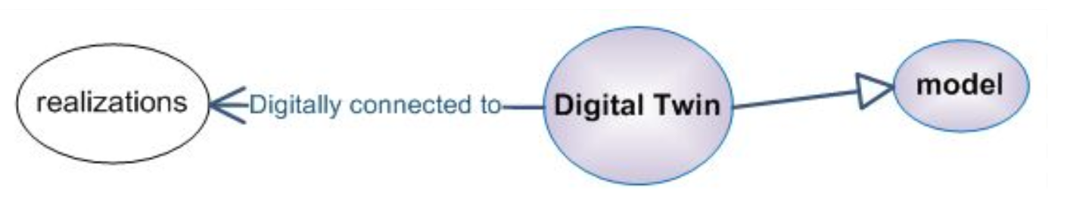
Digital Twin
*This is a prototype of proof used to determine definitions for terms.
Terms, definitions and related content is not released – DRAFT only
Notes:
The digital twin is not a single model that contains all the data, but rather a set of data that represents an endless opportunity of data content, type and formats to represent the physical part.
We have a terms and definitions group that has been hard at work creating proofs that represent the words we use to describe all this model-based stuff.
Our current definition for digital twin, although not yet released is:
A model digitally connected with its realization(s)..

Slide 5

Why a Model-Based Enterprise
Notes:
Why do we need a model-based enterprise?
Because today, our data is disconnected.
If we want to leverage the benefits of digital twin data, then we need an infrastructure that connects all that data together.

Slide 6
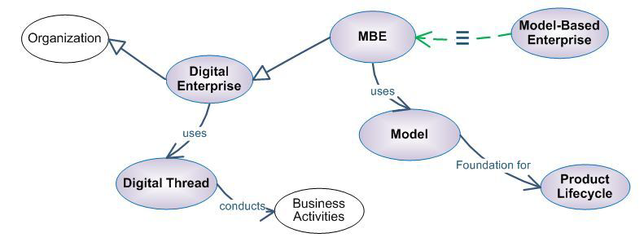
Model-Based Enterprise Definition
*This is a prototype of proof used to determine definitions for terms.
Terms, definitions and related content is not released – DRAFT only
Notes:
Our current best working definition (still under review) for a Model-Based Enterprise is: A digital enterprise that uses models as the foundation for the product lifecycle.

Slide 7
Why was the MBE Committee Formed
Future Needs Identified
Need to go beyond product definition and 3D DPD
Need for Systems-level thinking
Because system-level standard development requires managing complex integrations across a suite of standards, there is a need for model-based standards development
Need for standardization around data-centric communication within distributed, federated, and linked organization(s)
ASME Y14
Drawing and Document-Based Product Definition
Initial Model-Based Definition
3D Digital Product Definition (DPD)
Industry Practice & Other SDOs
Need for Digital Transformation across the Enterprise and throughout the lifecycle
Notes:
Realizing the business benefits of the digital twin are at the forefront of everyone's mind.
The ASME MBE Committee was formed to establish the standards needed in the Enterprise to realize a digital transformation.
It is an immense scope, and we have been developing terms and definitions, frameworks, and use-cases to establish the standards that are needed.
We want to develop standards in a different way that leverage model-based systems engineering techniques to help manage the complexity and inter-relationships of distributed, federated, and linked data.
Because of the gaps identified by many in industry and those of us who served in various ASME standards committees, the MBE committee was proposed to address creating standardization around the challenges faced by industry with disconnected data.

Slide 8

ASME MBE Standards Committee
Charter: Develop standards or related products that provide rules, guidance, and examples for the creation, use and reuse of model-based datasets, data models, and related topics within a Model-Based Enterprise.
Areas of Concentration
  Types of models and their intended uses
  Rules for representing requirements and constraints
  Types of features and data elements for model-based datasets
  Schemas for datasets
  Management of links between product definition and process definition
  Rules governing data quality
  Creation, management, and use of product definition and process definition data
  Management of discrepancies between existing standards affecting MBE and MBD
Notes:
<Read charter only>
Our charter is….

Slide 9
How we plan to write standards for a Model-Based Enterprise
Notes:
We started these activities in 2018, let’s take a quick retrospective look at our journey so far.

Slide 10
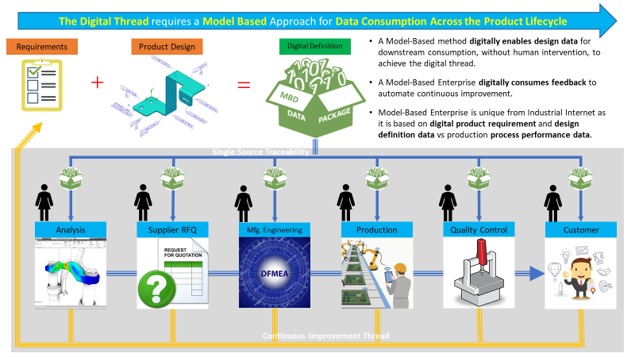
Goal: Enable the True Digital Thread
The Objective is to use an accepted set of data to obtain an integrated information flow that connects all phases of the product lifecycle.
Each product lifecycle phase includes requirements capture, computational analysis, design manufacturing, quality assurance, sustainment, and more.
Continuous improvement will utilize data in new ways as the future marches on.
Notes:
Our objective is to create a framework for operations utilizing any data possible to obtain an integrated information flow that connects all phases of the product lifecycle.
We are working to create common data elements across each phase of the lifecycle.
Our job is to consolidate industry practice today into methods that can be repeated by many organizations. This is the basis for our standards writing work.
And, we know there are ways that we don’t know about today that this data will be used in the future. So, we are desperately trying to not limit the framework, use cases, terms, and near-term activities to prevent us from leveraging data in new ways in the future.

Slide 11
ASME MBE Standards Committee Timeline
February 2018
Working Group formation approved by the ASME Board on Codes & Standards Operations and the Council on Standards and Certification
March 2019
MBE Standards Committee Formed
May 2019
First Call for Participation in MBE Working Groups
March-April 2020
Release of Request for Information (RFI) to aid in MBE Standards Development
April 2020
MBE Standards Committee and Working Group Meetings @ Virtual
Start
December 2018
MBE Steering recommendation report delivered to ASME
April 2019
First Public MBE Standards Committee Meeting @ NIST
November 2019
MBE Standards Committee Fall Meetings @ San Antonio, TX
September 2020
Initial findings from RFI published
November 2020
MBE Standards Committee Fall Meetings @ Virtual
Notes:
The ASME MBE committee journey began in February of 2018.
In 2019, we met several times, yes, actually face to face.
In 2020, we meet once a week as main committee, and the working groups meet every other week.
We have been able to get some work done this way.

Slide 12
ASME MBE Committee Structure
MBE Standards Committee
13 Members
~ 80+ Members
MBE Subject Matter Expert Support Group
Near Term Strategy
Working Group
(chartered)
Terms Working Group
(chartered)
Use Cases & Model Based Standards Development
Working Group
(chartered)
Framework
Working Group
(chartered)
Notes:
The MBE Standards Committee reports to the ASME Board on Standardization & Testing, and we currently have 13 members.
We have over 80 interested members working in the four working groups:
Near Term Strategy
Terms
Use Cases and MBSD
Framework

Slide 13
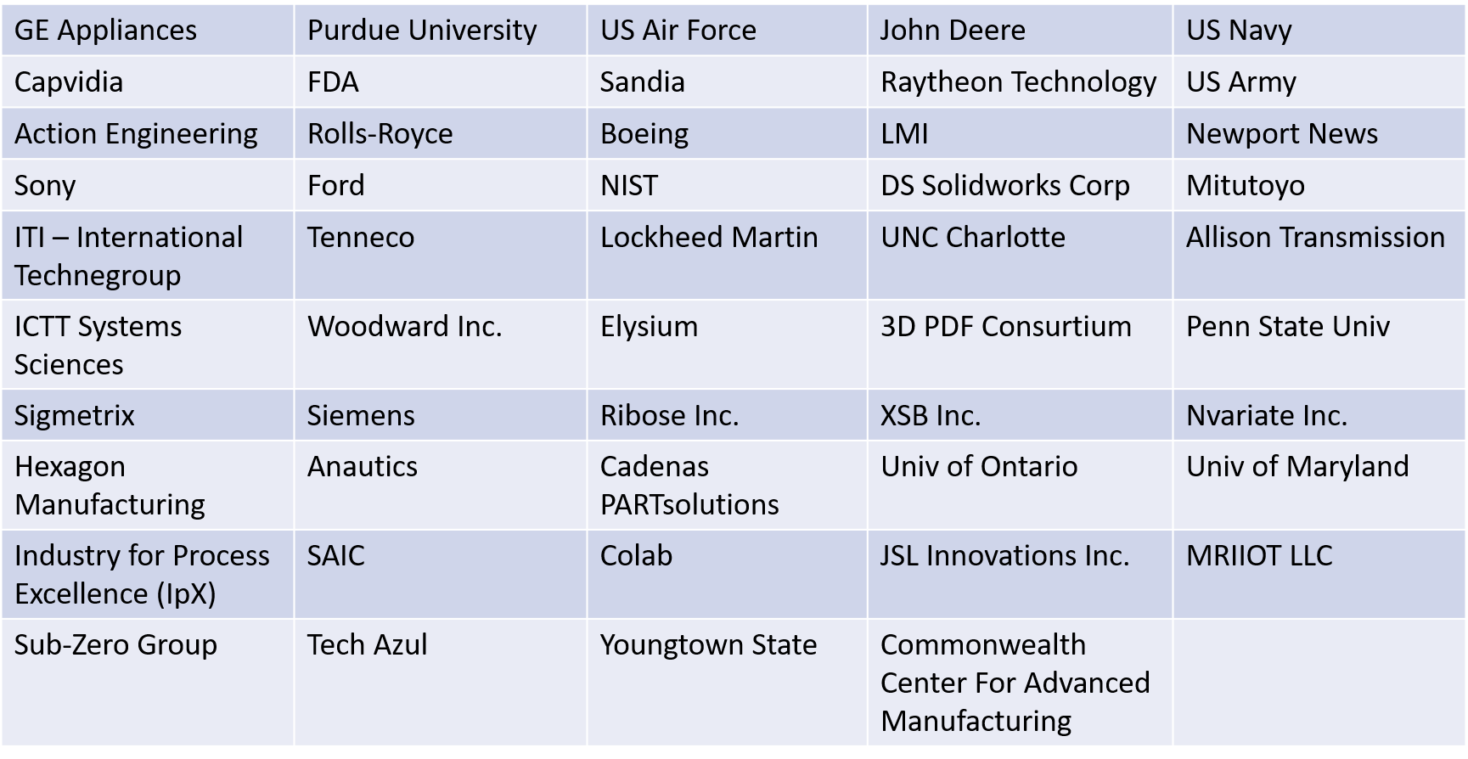
Organizations Represented in ASME MBE
Notes:
We have a broad base of industry represented to help bring a variety of perspectives to the work we produce.

Slide 14
Working Groups Overview and Status
Notes:
Let’s dive a little deeper into each working groups charter and status

Slide 15

Near Term Strategy Working Group
Leader: Bryan Fischer and Larry Bergquist larry.w.bergquist@outlook.com
Charter: Identifies challenges, gaps, and problems inhibiting understanding and adoption of model-based methods.
Status
Focused on two-year timeframe
Meeting during the fall meetings to establish tactical plans to address strategic needs
Notes:
<Read the charter and the status>

Slide 16
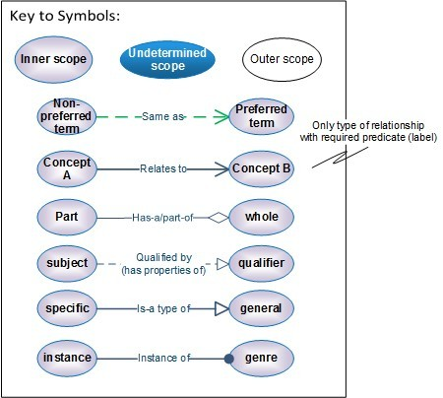
Terms Working Group
Leader: Curtis Brown, cbrown@kcnsc.doe.gov
Charter: Collect and define terms, acronyms, and abbreviations for use in ASME MBE Standards
Status
Developed a “model proof” technique to diagram each term with relationships to other terms
Gathered and proofed a large set of terms and definitions
Submitted 48 terms to the main MBE committee for review.
  Each term included a broad definition along with a model proof.
Received feedback on 8 high priority terms and now working to understand how these 8 terms fit within the framework proposed by the Framework Working Group.
*Content is not released – DRAFT only
Notes:
<Read the charter and the status>

Slide 17
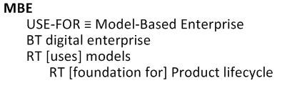
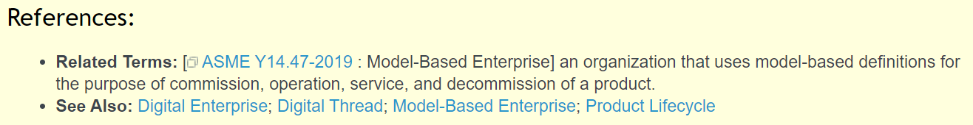
Top Terms
Digital Enterprise
Digital Thread
Native Model
Model-Based Definition
Model
Model-Based Enterprise
Product Lifecycle
Product Lifecycle Management
Notes:
These are the top 8 terms under consideration.
What you see on the right side of the screen is an example of a “model proof”
This is the diagram of a Model-Based Enterprise, where we include relationships to other terms within our study,
And identify the type of relationship using the codes.
I’ve been involved in many definition writing activities, and I like this method the best.
The model proofs and our rules for good definitions take some of the subjectivity out of the definition process, other definition methods tend to be very subjective.
It cuts-down on the ambiguity and mis-interpretation of the definitions.
Note also that on our Redmine web-page where these proofs are documented, we also collect references to other terms and definitions in other standards organizations

Slide 18
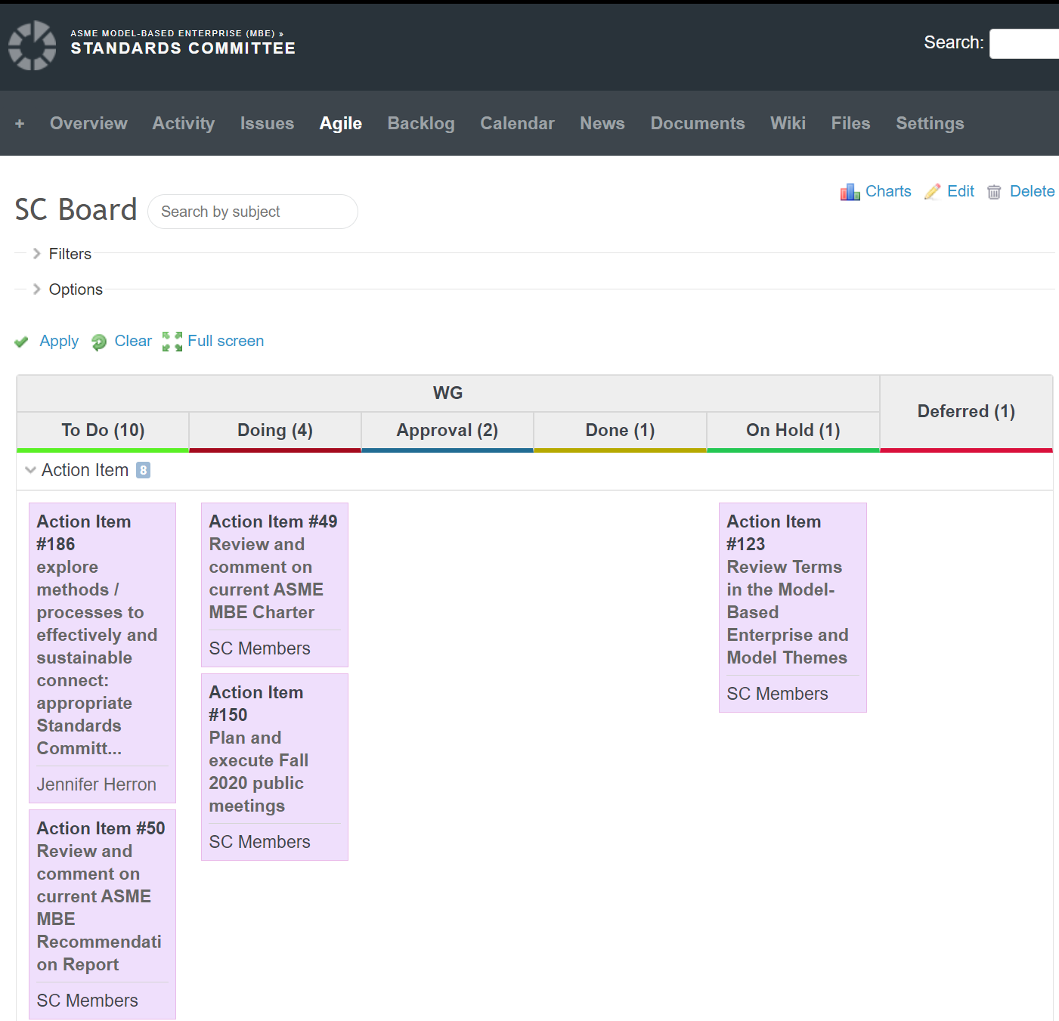
UCMBSD Working Group
Use Cases and Model-Based Standards Development (MBSD) Methodology
Leader: Will Sobel, will@govimana.com
Charter: Define methods that the MBE Standards Committee will use to develop use cases and model-based standards
Status
Developed, Sent, Analyzed a Request for Information (RFI) survey to solicit stakeholder input
Baseline trained working group in ontology theory
Rolled out an Agile process with-in Redmine to release standards
Defined initial ways to collaborate on those standards
Created a draft of a reference modeling methodology
Notes:
<Read the charter and the status>

Slide 19
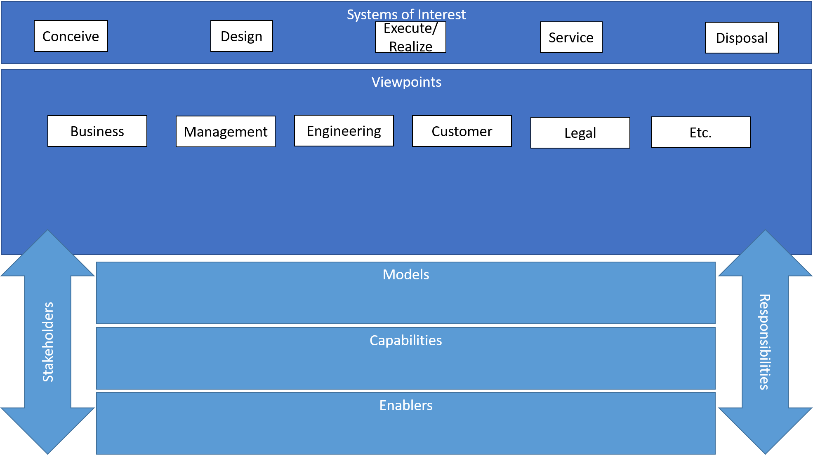
Framework Working Group
Leader: Tom Hedberg thedberg@umd.edu
Charter: Define the concept of a Model-Based Enterprise by providing a high-level structural definition
Status
Surveyed existing Concept of Operations, Frameworks, Taxonomies, and more
Created version 1 of a baseline framework
*Content is not released – DRAFT only
Notes:
The MBE Framework has two goals:
Providing adopters to map their businesses to the framework
Enabling MBE standards implementers to quickly discover the MBE architectures and specifications that apply to their viewpoint and system of interes
<Read the charter and the status>

Slide 20
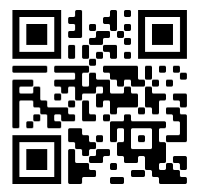
ASME MBE Recommendation Report
A Starting Point for MBE Standards Activities
  Developed by the ASME MBE Steering Group, which consisted of 8 existing ASME volunteers and 2 new members
  Establishes direction, activities, priorities, and organizational structure of the ASME MBE Standards Committee and its subcommittees
  Presents background and motivation for MBE
  Provides methodology for developing MBE standards using a model-based approach
  Outlines a roadmap for the MBE standards development process
  Describes a marketing and adoption strategy for MBE
  “MBE will transform industry by increasing productivity, quality, profitability, and types of products, and by reducing wasted effort, wasted time, non-value-added work, lost information, missed opportunities, and time to market.”
Download: go.asme.org/MBEreport
Notes:
At the end of 2018, we wrote a report to define our activities.
This report is publicly available through the QR code, or go.asme.org/MBEreport
I encourage you to review it.

Slide 21

We need …
Domain experts from diverse industry sectors, such as:
  Automotive
  Medical
  Infrastructure
Enterprise architects with modeling expertise
Experts and liaisons from other standards organizations
Notes:
If you would like get involved, we do have a very full membership, however, we do regularly review our who are regular contributors, versus who are not. If you have a systems modeling background and are interested in our subject, we would love to hear from you.

Slide 22
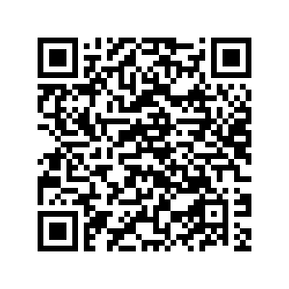
How to Get Involved
Complete the PAF and PF-1 forms. Send them to the ASME Staff Secretary, Fred Constantino (constantinof@asme.org).
Then you will:
  become a member of the MBE Subject Matter Expert Support Group;
  be granted access to C&S Connect and the MBE Collaboration Site; and
  be able to participate with Working Group once the above is complete. Contact the Working Group Leader to start contributing.
Join an ASME Standards & Certification Committee
Notes:
If you would like get involved, we do have a very full membership, however, we do regularly review our who are regular contributors, versus who are not. If you have a systems modeling background and are interested in our subject, we would love to hear from you.

Slide 23
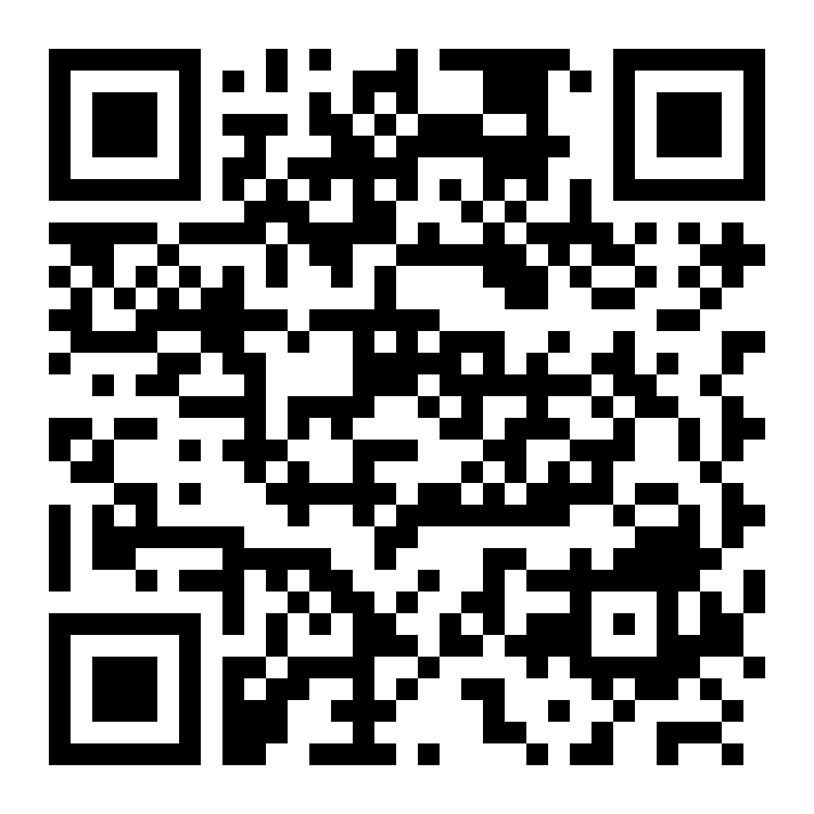
Want to Learn More?
Fredric Constantino - MBE Standards Committee Staff Secretary
  ASME S&C Project Engineering Advisor
  E-mail: ConstantinoF@asme.org
Michelle Pagano – MBE Staff Support
  ASME S&C Engineer
  E-mail: PaganoM@asme.org
Jennifer Herron – MBE Vice-Chair, Communications Director
  E-mail: Jennifer@action-engineering.com
Tom Hedberg – MBE Chair
  E-mail: thedberg@umd.edu
ASME MBE Standards Committee C&S Connect Page
  https://cstools.asme.org/csconnect/CommitteePages.cfm?Committee=102216151
ASME MBE Redmine Collaboration Site
  https://projects.mbe.institute/projects/asme-mbe-public-page
Scan Me: Collaboration Site

